Slide 1
Relational Algebra
π
By relieving the brain of all unnecessary work, a good notation sets it free to concentrate on more advanced problems, and, in effect, increases the mental power of the race.
-- Alfred North Whitehead (1861 - 1947)

Slide 2
Relational Query Languages
Query languages: Allow manipulation and retrieval of data from a database.
Relational model supports simple, powerful QLs:
  Strong formal foundation based on logic.
  Allows for much optimization.
Query Languages != programming languages!
  QLs not expected to be “Turing complete”.
  QLs not intended to be used for complex calculations.
  QLs support easy, efficient access to large data sets.

Slide 3
Formal Relational Query Languages
Two mathematical Query Languages form the basis for “real” languages (e.g. SQL), and for implementation:
Relational Algebra: More operational, very useful for representing execution plans.
Relational Calculus: Lets users describe what they want, rather than how to compute it. (Non-procedural, declarative.)
Understanding Algebra & Calculus is key to
understanding SQL, query processing!

Slide 4
Preliminaries
A query is applied to relation instances, and the result of a query is also a relation instance.
  Schemas of input relations for a query are fixed (but query will run over any legal instance)
  The schema for the result of a given query is also fixed. It is determined by the definitions of the query language constructs.
Positional vs. named-field notation:
  Positional notation easier for formal definitions, named-field notation more readable.
  Both used in SQL
    Though positional notation is not encouraged

Slide 5
Relational Algebra: 5 Basic Operations
Selection ( σ ) Selects a subset of rows from relation (horizontal).
Projection ( π ) Retains only wanted columns from relation (vertical).
Cross-product ( × ) Allows us to combine two relations.
Set-difference ( — ) Tuples in r1, but not in r2.
Union ( ∪ ) Tuples in r1 or in r2.
Since each operation returns a relation, operations can be composed! (Algebra is “closed”.)

Slide 6
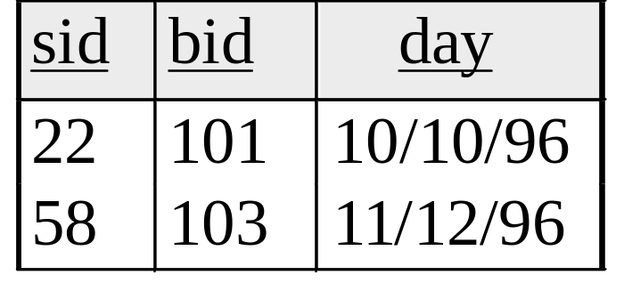
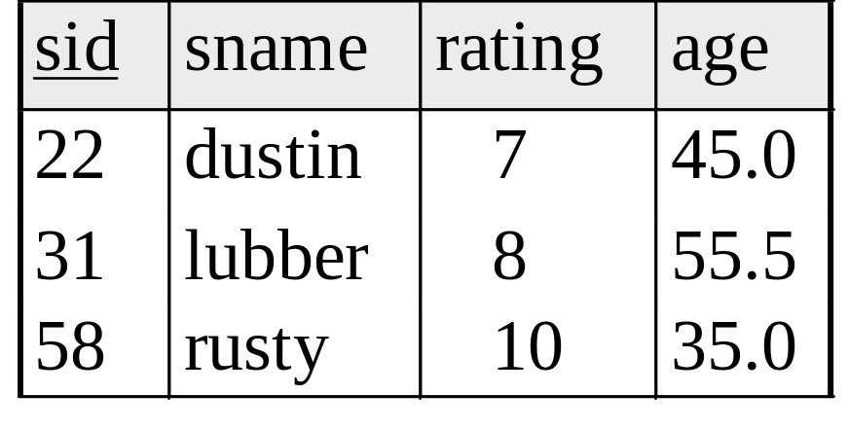
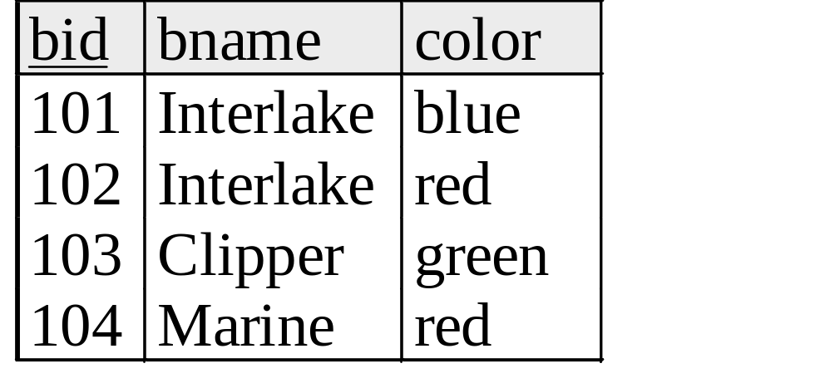
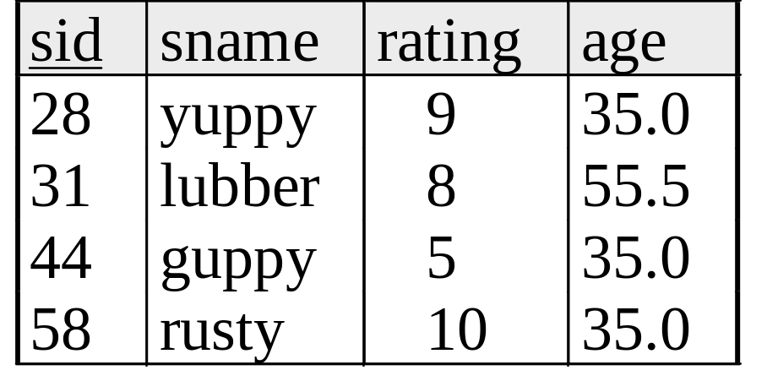
Example Instances
R1
S1
Boats
S2

Slide 7
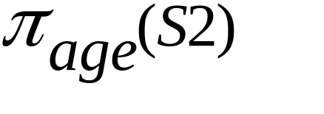
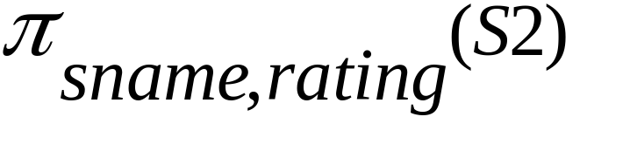
Projection (π)
Examples: ;
Retains only attributes that are in the “projection list”.
Schema of result:
  exactly the fields in the projection list, with the same names that they had in the input relation.
Projection operator has to eliminate duplicates (How do they arise? Why remove them?)
  Note: real systems typically don’t do duplicate elimination unless the user explicitly asks for it. (Why not?)

Slide 8
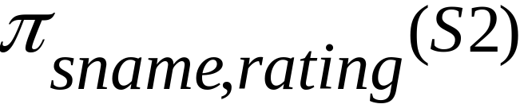
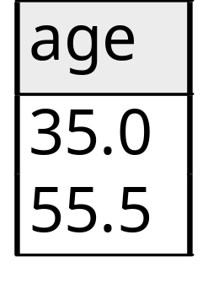
Projection (π)
sname
rating
yuppy
9
lubber
8
guppy
5
rusty
10
S2

Slide 9
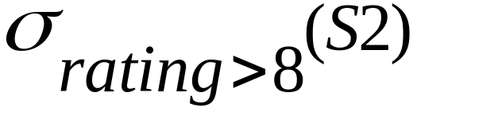
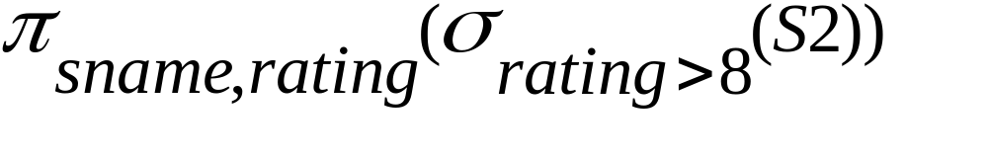
Selection (σ)
Selects rows that satisfy selection condition.
Result is a relation.
  Schema of result is same as that of the input relation.
Do we need to do duplicate elimination?
sid
sname
rating
age
28
yuppy
9
35.0
sname
rating
31
lubber
8
55.5
yuppy
9
44
guppy
5
35.0
58
rusty
10
35.0
rusty
10

Slide 10
Union and Set-Difference
Both of these operations take two input relations, which must be union-compatible:
  Same number of fields.
  `Corresponding’ fields have the same type.
For which, if any, is duplicate elimination required?

Slide 11
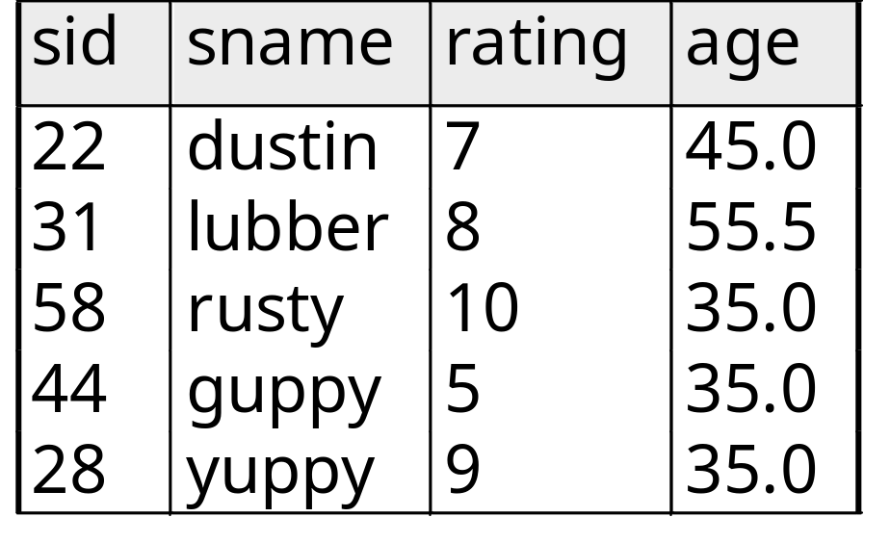

Union
S1
S2

Slide 12
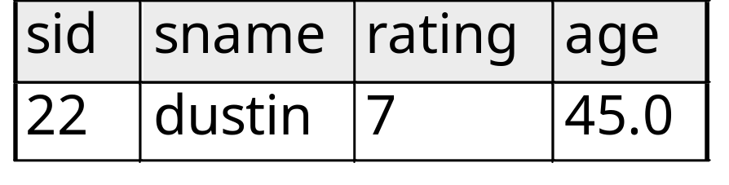

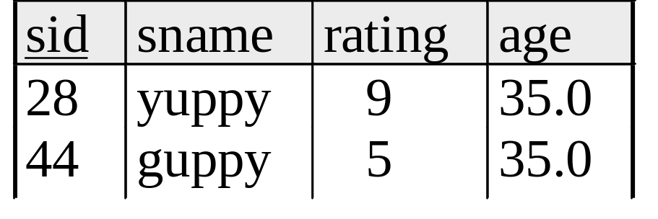
Set Difference
S1
S2 – S1
S2

Slide 13
Cross-Product
S1 × R1: Each row of S1 paired with each row of R1.
Q: How many rows in the result?
Result schema has one field per field of S1 and R1, with field names `inherited’ if possible.
  May have a naming conflict: Both S1 and R1 have a field with the same name.
  In this case, can use the renaming operator:

Slide 14
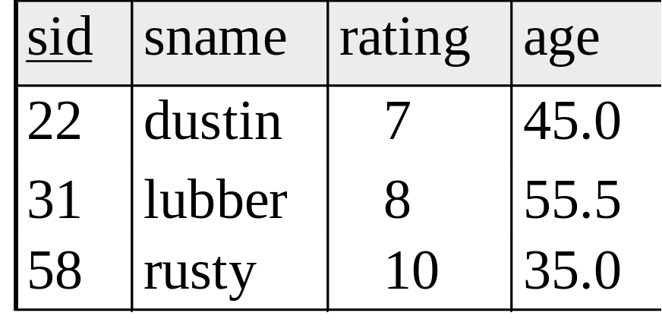
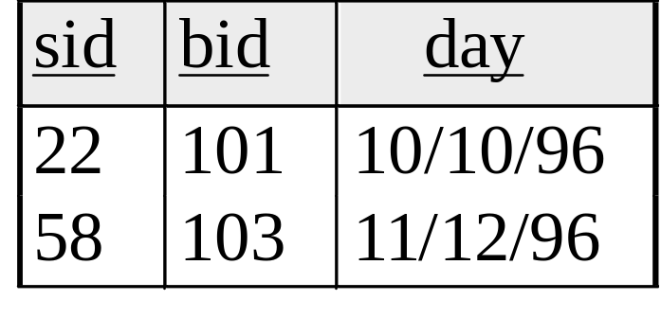
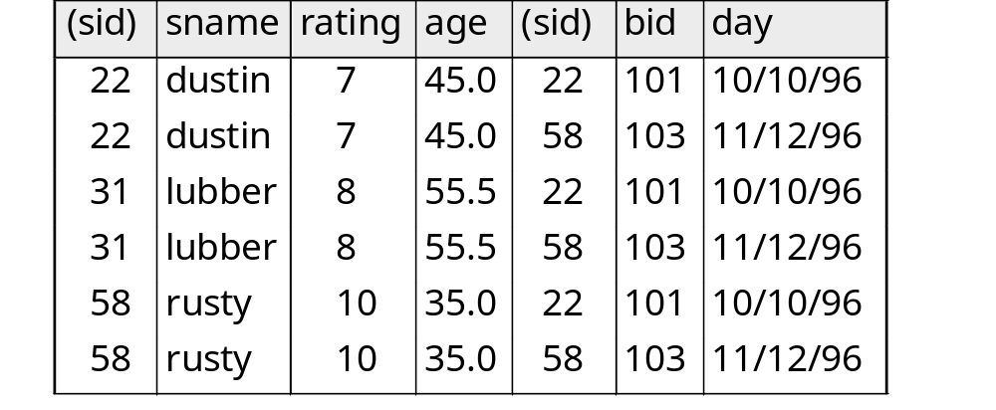
Cross Product Example
R1
S1
R1 X S1 =

Slide 15
Compound Operator: Intersection
In addition to the 5 basic operators, there are several additional “Compound Operators”
  These add no computational power to the language, but are useful shorthands.
  Can be expressed solely with the basic ops.
Intersection takes two input relations, which must be union-compatible.
Q: How to express it using basic operators?
R ∩ S = R − (R − S)

Slide 16
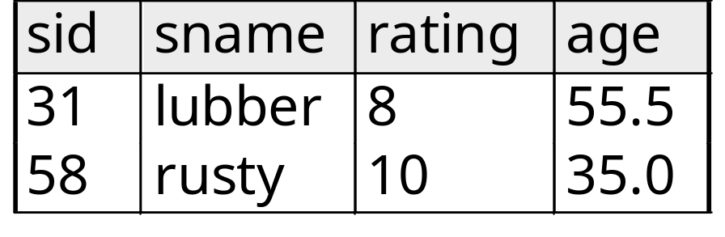

Intersection
S1
S2

Slide 17
Compound Operator: Join
Joins are compound operators involving cross product, selection, and (sometimes) projection.
Most common type of join is a “natural join” (often just called “join”). R S conceptually is:
  Compute R × S
  Select rows where attributes that appear in both relations have equal values
  Project all unique atttributes and one copy of each of the common ones.
Note: Usually done much more efficiently than this.

Slide 18
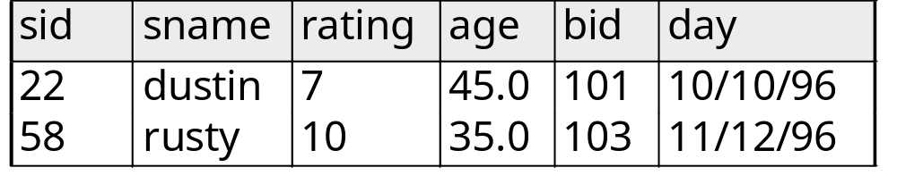
Natural Join Example
R1
S1
S1 R1 =

Slide 19

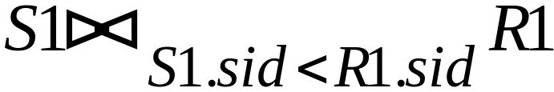
Other Types of Joins
Condition Join (or “theta-join”):
Result schema same as that of cross-product.
May have fewer tuples than cross-product.
Equi-Join: Special case: condition c contains only conjunction of equalities.
(
sid)
sname
rating
age
(
sid)
bid
day
22
dustin
7
45.0
58
103
11/12/96
31
lubber
8
55.5
58
103
11/12/96

Slide 20
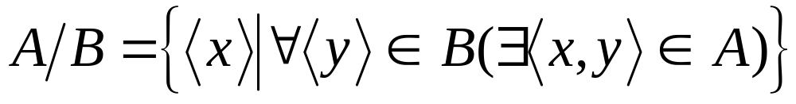
Compound Operator: Division
Useful for expressing “for all” queries like: Find sids of sailors who have reserved all boats.
For A/B, attributes of B must be subset of attrs of A.
  May need to “project” to make this happen.
E.g., let A have 2 fields, x and y; B have only field y:
  A/B contains all tuples (x) such that for every y tuple in B, there is an xy tuple in A.

Slide 21
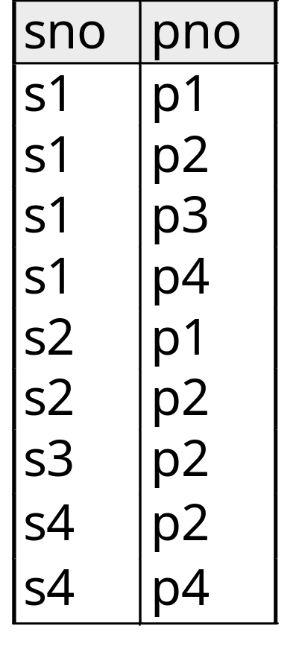
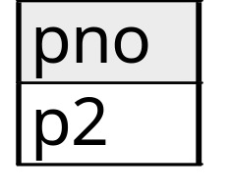
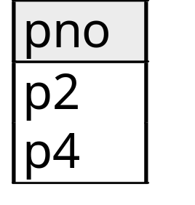
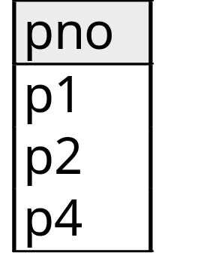
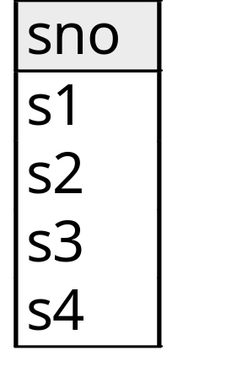
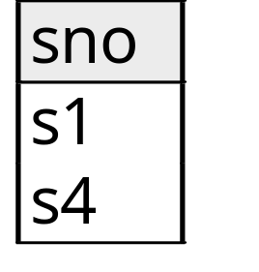
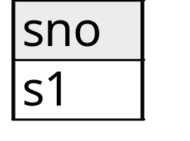
Examples of Division A/B
Q for intuition: What is (R/S)×S?
B1
B2
B3
A
A/B1
A/B2
A/B3

Slide 22
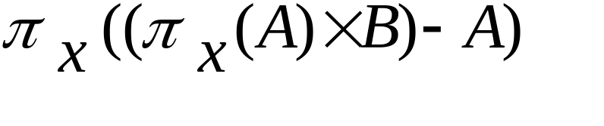
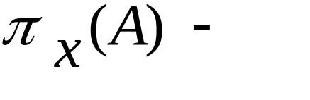
Expressing A/B Using Basic Operators
Division is not essential op; just a useful shorthand.
  (Also true of joins, but joins are so common that systems implement joins specially.)
Idea: For A(x,y)/B(y), compute all x values that are not `disqualified’ by some y value in B.
  x value is disqualified if by attaching y value from B, we obtain an xy tuple that is not in A.
  Disqualified x values:
A/B:
Disqualified x values

Slide 23
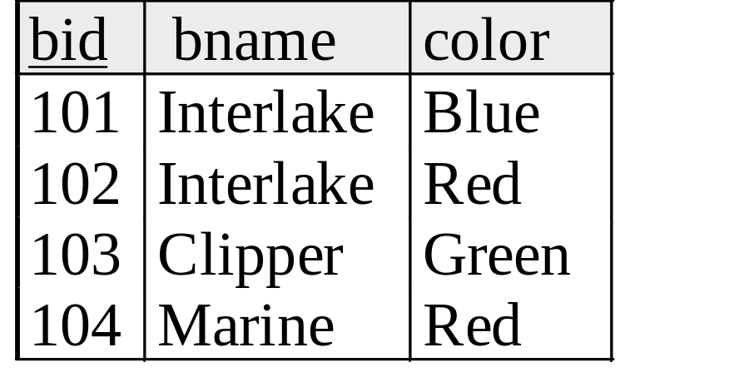
Examples
Reserves
Sailors
Boats

Slide 24
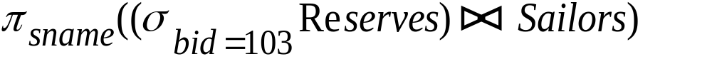
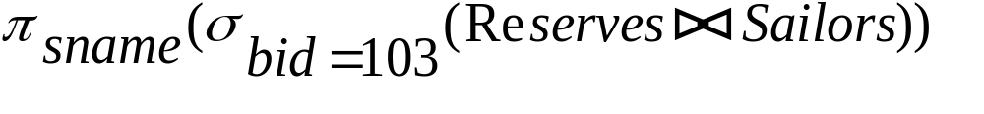
Find names of sailors who’ve reserved boat #103
Solution 1:
Solution 2:

Slide 25
Find names of sailors who’ve reserved a red boat
Information about boat color only available in Boats; so need an extra join:
A more efficient solution:
A query optimizer can find this given the first solution!

Slide 26
Find sailors who’ve reserved a red or a green boat
Can identify all red or green boats, then find sailors who’ve reserved one of these boats:

Slide 27
Find sailors who’ve reserved a red and a green boat
Cut-and-paste previous slide?

Slide 28
Find sailors who’ve reserved a red and a green boat
Previous approach won’t work! Must identify sailors who’ve reserved red boats, sailors who’ve reserved green boats, then find the intersection (note that sid is a key for Sailors):

Slide 29
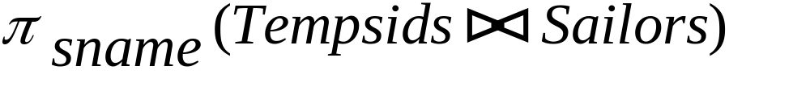
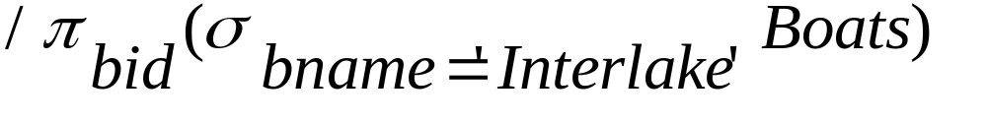
Find the names of sailors who’ve reserved all boats
Uses division; schemas of the input relations to / must be carefully chosen:
To find sailors who’ve reserved all ‘Interlake’ boats:
.....

Slide 30
Summary
Relational Algebra: a small set of operators mapping relations to relations
  Operational, in the sense that you specify the explicit order of operations
  A closed set of operators! Can mix and match.
Basic ops include: σ, π, ×, ∪, —
Important compound ops: ∩, , /

